Slide 1



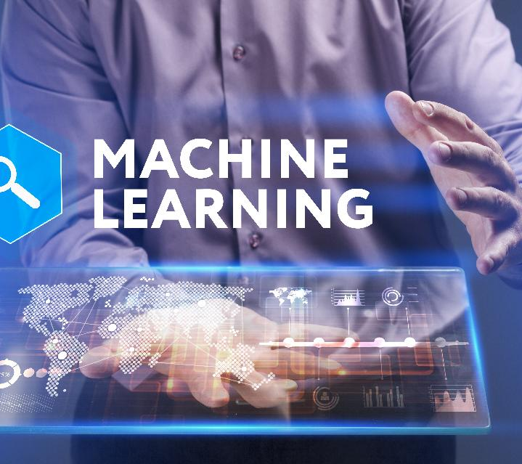
HYBRID MACHINE LEARNING PROJECT

Slide 2
Presentation :- Image processing
Title: - "Machine Learning-Based Image processing Project"
SUBMITTED TO :- dr. Vijay Kumar Dwivedi
TEAM: - RITIK KAPIL AND HARSH SRIVASTAVA

Slide 3
Introduction on Image processing
its ability to manipulate and analyze images or visual data.
Minimize data usage and optimize loading for users with limited internet access.
Machine learning plays a crucial role in image processing by enabling computers to automatically analyze, understand, and manipulate images.

Slide 4


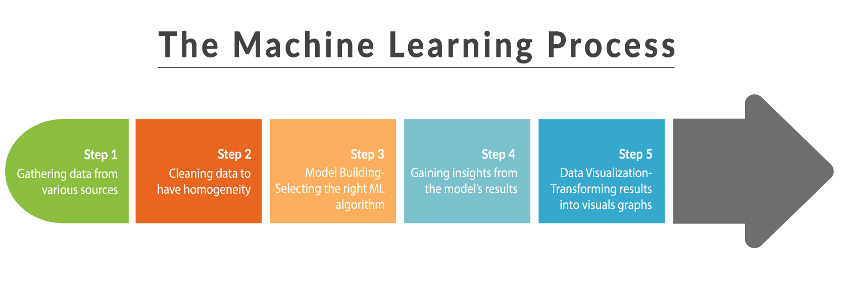
Slide 3: Project Overview

Slide 5
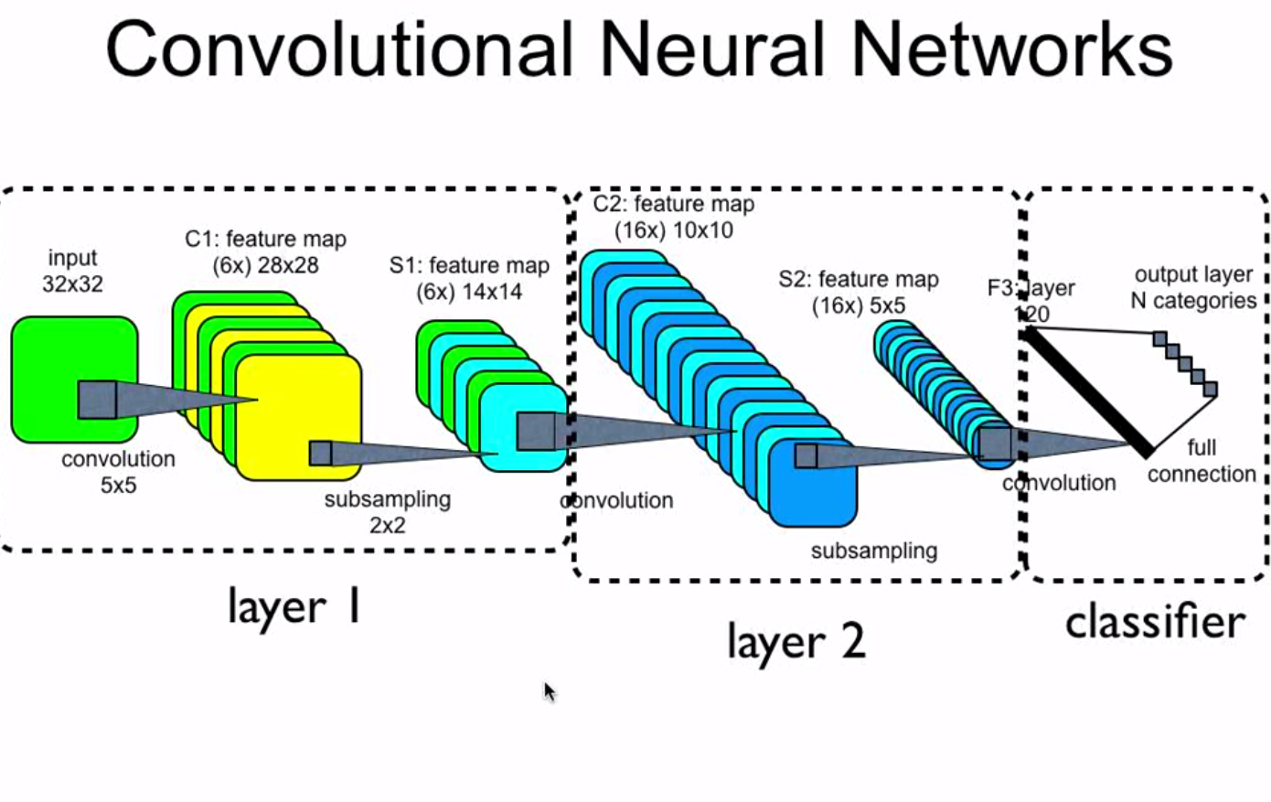
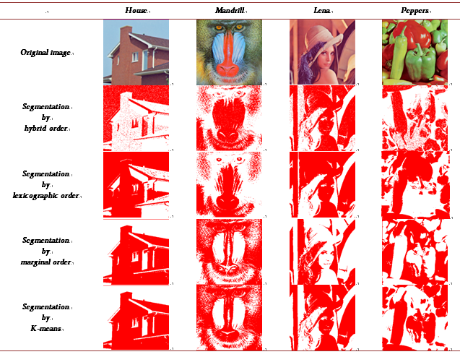
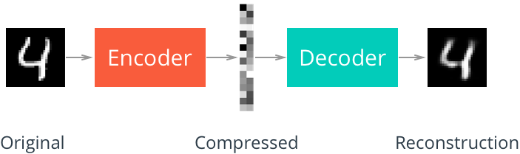
Machine Learning Approach
Convolutional Neural Networks (CNNs)
Image Segmentation
Autoencoders:
This Photo by Unknown author is licensed under CC BY-NC.
This Photo by Unknown author is licensed under CC BY.
This Photo by Unknown author is licensed under CC BY-SA.

Slide 6

Language Introduction
Python is easy to learn and powerful.
It offers efficient high-level data structures.
Python uses a simple yet effective approach to object-oriented programming.
It features elegant syntax and dynamic typing.
Python is ideal for scripting and rapid application development across various platforms.
This Photo by Unknown author is licensed under CC BY-NC.

Slide 7
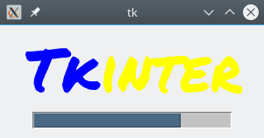
GUI using tkinter in python
Python provides several GUI development options.
tkinter is the most widely used GUI method.
tkinter is a standard Python interface to the Tk GUI toolkit.
Python with tkinter is the fastest and easiest way to create GUI applications.
This Photo by Unknown author is licensed under CC BY-SA.

Slide 8
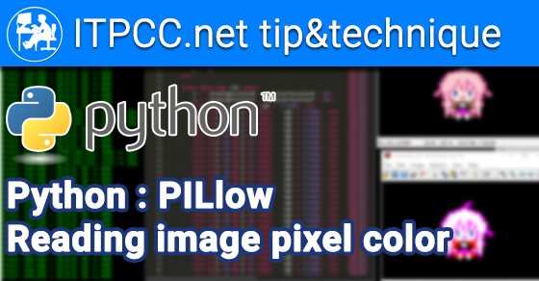
Pillow (a fork of PIL)
Python Imaging Library (PIL) was the primary image processing package for Python.
It provided tools for image editing, creation, and saving.
PIL support was discontinued in 2011.
Pillow, a fork of PIL, added support for Python 3.x and became its replacement.
Pillow supports various image formats and encourages adding new format support through file decoders.

Slide 9

Step of image processing
Upload Images: Users can upload their images directly to the application.
Select Resize Options: The application should provide options to choose dimensions or a percentage for resizing.
Optimization Settings: Users can adjust image quality/compression settings to optimize file size.
This Photo by Unknown author is licensed under CC BY-SA.

Slide 10
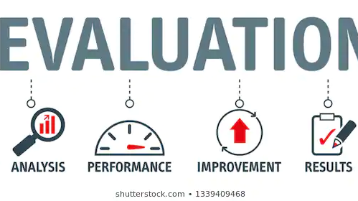

Performance Evaluation
Choose
Choose Images: Select the original image (before) and the optimized image (after) that you want to showcase.
Use
Use Image Editing Software: Open an image editing tool like Photoshop or a free online editor like Canva.
Create
Create a Side-by-Side Comparison: Arrange both images side by side within the editing software.

Slide 11
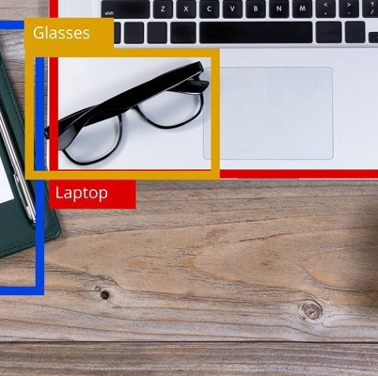
Benefits of Image processing
Enhanced Visual Information: It improves image quality for clearer interpretation and analysis.
Automation and Efficiency: Enables automated tasks like object detection, saving time and reducing errors.
Medical Diagnosis: Aids in early disease detection through medical imaging.
This Photo by Unknown author is licensed under CC BY-NC-ND.

Slide 12
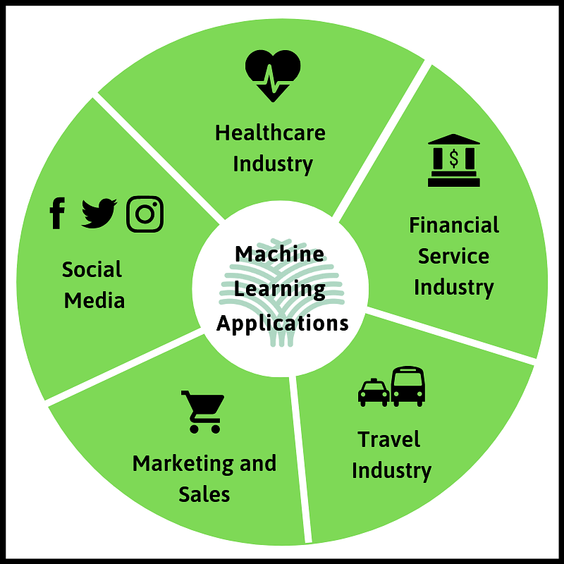
APPLICATION OF MACHINE LEARNING
Healthcare: ML aids in disease diagnosis, drug discovery, and personalized treatment plans based on patient data.
Finance: ML models predict stock prices, detect fraud, and optimize investment portfolios.
Autonomous Vehicles: ML algorithms enable self-driving cars to perceive their environment and make driving decisions.
Natural Language Processing: Used in chatbots, language translation, and sentiment analysis for customer service and communication.
Image Recognition: ML identifies objects in images, essential for facial recognition, security systems, and content tagging.

Slide 13
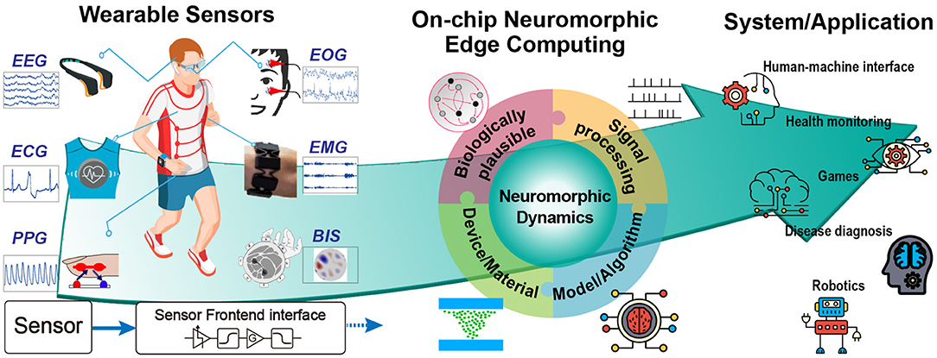
Conclusion and Future Directions
Improved Image Quality: ML-based image resizers can retain image quality while reducing size,
Optimized Loading Times: Faster-loading web pages and applications lead to improved user engagement and reduced bounce rates
Bandwidth Savings: Reduced image file sizes save on bandwidth costs for website owners and benefit users with limited data plans
Cross-Platform Compatibility: ML-based resizers can adapt images for various devices and screen sizes
Future Potential: As machine learning continues to advance, these resizers can adapt and improve
This Photo by Unknown author is licensed under CC BY.

Slide 14

Thank You

